Slide 1
Economic Injury Disaster Loans
For Coronavirus Related Economic Disruptions

Slide 2
SBA Economic Injury Disaster Loan Program
Declaration process
Governor’s Certification/Request
SBA Administrator Approves Declaration
Type of loan
Working capital loan
Used to pay business expenses
Notes:
The loans are not intended to replace lost sales or profits or for expansion.

Slide 3
Economic Injury Disaster Loan - Terms
Working Capital Loan Program
Eligible entities may qualify for loans up to $2 million.
The interest rates for this disaster are 3.75 % for small businesses 2.75 % for nonprofit organizations
Terms up to 30 years
First payment deferred for one year
Eligibility
Based on the size (must be a small business)
Type of business
Financial resources
Notes:
The loans are not intended to replace lost sales or profits or for expansion.

Slide 4
Economic Injury Disaster Loan Advance
On Friday, March 27, President Trump signed into law the CARES Act, which provides additional assistance for small business owners, including the opportunity to receive up to a $10,000 Advance on an Economic Injury Disaster Loan for emergency capital.
The form to apply is part of the Economic Injury Disaster Loan application. If approved, these funds can be used for payroll and other operating expenses and will be forgiven.
Visit sba.gov/disaster to apply for both the Economic Injury Disaster Loan and Economic Injury Disaster Loan Advance.
Those who have already applied for the loan will receive guidance through email. New applicants will automatically be considered for both EIDL and EIDL Advance.
Notes:
The loans are not intended to replace lost sales or profits or for expansion.

Slide 5
Economic Injury Disaster Loan - Terms
What businesses are eligible to apply?
small businesses
small agricultural cooperatives
small aquaculture businesses
most private non-profit organizations
How can I use the loan funds?
Fixed debts
Payroll
Accounts payable
Other bills that could have been paid had the disaster not occurred
Notes:
The loans are not intended to replace lost sales or profits or for expansion.

Slide 6
Economic Injury Disaster Loan Terms
What are the collateral requirements?
Economic Injury Disaster Loans over $25,000 require collateral.
SBA takes real estate as collateral when it is available.
Lack of collateral is not a reason for decline.
6
Notes:
What are the collateral requirements?
Economic Injury Disaster Loans over $25,000 require collateral.
SBA takes real estate as collateral when it is available.
SBA will not decline a loan for lack of collateral, but requires borrowers to pledge what is available.

Slide 7
SBA’s Working Capital Loans are Different from Other SBA Loans
SBA’s Economic Injury Disaster Loan (EIDLs) funds come directly from the U.S. Treasury.
Applicants do not go through a bank to apply. Instead apply directly to SBA’s Disaster Assistance Program at: DisasterLoan.sba.gov
There is no cost to apply.
There is no obligation to take the loan if offered.
The maximum unsecured loan amount is $25,000.
Applicants can have an existing SBA Disaster Loan and still qualify for an EIDL for this disaster, but the loans cannot be consolidated.

Slide 8
Size Standards
What defines small business?
Traditional Industry Size Max - NAICS
Retail or Service - $8 - $35M
Construction – up to $39.5M
Manufacturing – 500 Employees
Wholesale - 100 Employees
Notes:
The SBA maintains a detailed listing of size standards that determine eligibility as a small business for financial assistance under our loan guaranty programs.
Generally, manufacturing operations with 500 or fewer employees and wholesaling operations with 100 or fewer employees are eligible. Service and retail operations are measured on total annual sales and they cannot exceed $7 million to qualify.
SBA sets size standards that establish which businesses are considered small for certain government programs. The Small Business Jobs Act directs SBA to establish a new alternative size standard based on tangible net worth and net income for determining size eligibility for its 7(a) and 504 loan programs.
This new, temporary alternative size standard is established by the Small Business Jobs Act, which states, in part:
(i) the maximum tangible net worth of the applicant is not more than $15,000,000; and
(ii) the average net income after Federal income taxes (excluding any carry-over losses) of the applicant for the 2 full fiscal years before the date of the application is not more than $5,000,000.

Slide 9
SBA’s Economic Injury Disaster Loan Basics
What is the criteria for a loan approval?
Credit History-Applicants must have a credit history acceptable to SBA. Repayment –SBA must determine that the applicant business has the ability to repay the SBA loan.
Eligibility- The applicant business must
be physically located in a declared county
Have suffered working capital losses due to the declared disaster

Slide 10
Ineligible Entities
What are some of the businesses that are ineligible for an Economic Injury Disaster Loan?
Agricultural Enterprises -If the primary activity of the business (including its affiliates) is as defined in Section 18(b)(1) of the Small Business Act, neither the business nor its affiliates are eligible for EIDL assistance.
Gambling Concerns (Ex: Concerns that derive more that 1/3 of their annual gross revenue from legal gambling activities)
Casinos & Racetracks (Ex: Businesses whose purpose for being is gambling (e.g., casinos, racetracks, poker parlors, etc.) are not eligible for EIDL assistance regardless of 1/3 criteria above.
10
Notes:
Nonprofits of any size are eligible, including faith based organizations that provide secular social services to the general public (e.g., child care services, housing and shelter services, and prepared and unprepared food distribution services).

Slide 11
How to Apply
SBA’s Customer Service Representatives are ready to serve.
Electronic Loan Application (ELA) at www.sba.gov/disaster
Paper loan applications can be downloaded from www.sba.gov/disaster. Completed applications should be mailed to: U.S. Small Business Administration, Processing and Disbursement Center, 14925 Kingsport Road, Fort Worth, TX 76155 (Not recommended).
Disaster loan information and application forms may also be obtained by calling the SBA’s Customer Service Center at 800-659-2955 (800-877-8339 for the deaf and hard-of-hearing) or by sending an email to disastercustomerservice@sba.gov.

Slide 12
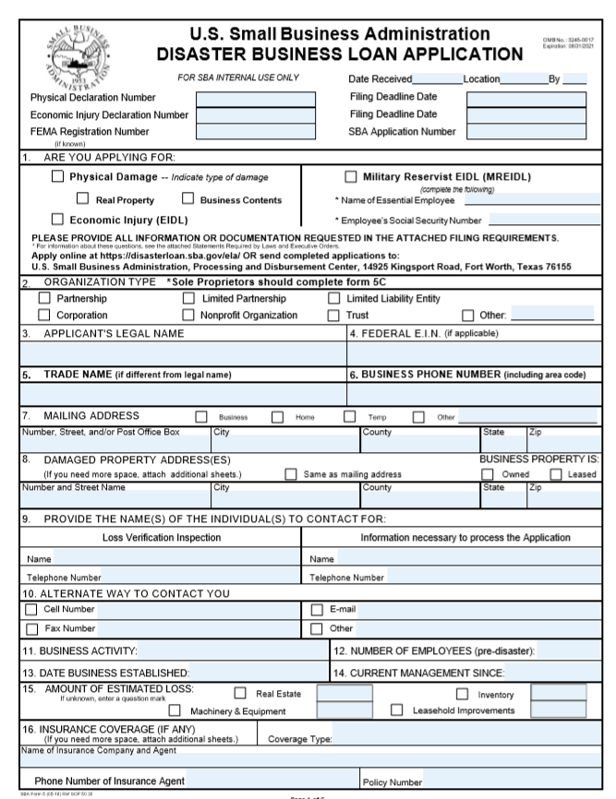
Basic Filing Requirements
Completed SBA loan application (SBA Form 5).
Tax Information Authorization (IRS Form 4506T) for the applicant, principals and affiliates.
Complete copies of the most recent Business Federal Income Tax Return.
Schedule of Liabilities (SBA Form 2202).
Personal Financial Statement (SBA Form 413).
Other Information may be requested.
*Although a paper application and forms are acceptable, filing electronically is easier, faster and more accurate.
12
Notes:
Include all schedules of the federal tax return

Slide 13
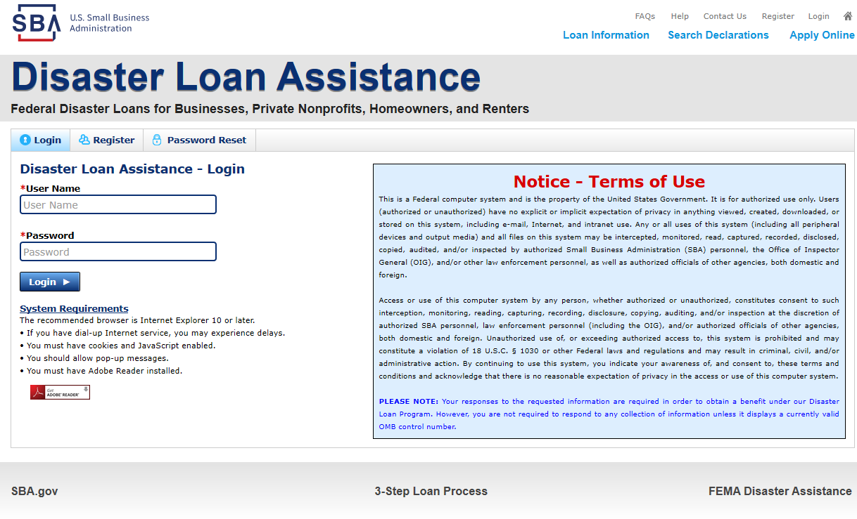
Additional Filing Requirements
Other information that may be requested:
Most recent personal Federal income tax returns including all schedules, of for principals, general partners or managing member, and affiliates.
If the most recent Federal income tax return has not been filed, a year-end profit-and-loss statement and balance sheet for that tax year .
A current year-to-date profit-and-loss statement .
Additional Filing Requirements (SBA Form 1368) providing monthly sales figures. (This is especially important for Economic Injury Disaster Loans.)
13
Notes:
Complete copy, including all schedules, of the most recent Federal income tax return for principals, general partners or managing member, and affiliates (see filing requirements for more information).
If the most recent Federal income tax return has not been filed, a year-end profit-and-loss statement and balance sheet for that tax year .
A current year-to-date profit-and-loss statement .
Additional Filing Requirements (SBA Form 1368) providing monthly sales figures. (This is especially important for Economic Injury Disaster Loans.)

Slide 14
Assistance From SBA and Partners
Free assistance with reconstructing financial records, preparing financial statements and submitting the loan application is available from any of SBA’s partners: Small Business Development Centers (SBDCs), SCORE, Women’s Business Centers (WBC), and Veteran’s Business Outreach Centers and local Chambers of Commerce.
For the nearest office, visit: https://www.sba.gov/local-assistance
Illinois District is hosting two training sessions daily (11a and 3p)
Go to www.sba.gov/il for more information.

Slide 15
Tips Before You Submit
Recheck the filing requirements to ensure that all the needed information is submitted.
The biggest reason for delays in processing is due to missing information. Make sure to complete all filing requirements before submitting the application and forms.
If more funds are needed, applicants can submit supporting documents and a request for an increase. If less funds are needed, applicants can request a reduction in the loan amount.
If the loan request is denied, the applicant will be given up to six months in which to provide new information and submit a written request for reconsideration.

Slide 16
Express Bridge Loan pilot program
If a small business has an urgent need for cash while waiting for an Economic Injury Disaster Loan decision and disbursement, they may qualify for an SBA Express Disaster Bridge Loan.
Small businesses who currently have a business relationship with an SBA Express Lender can access up to $25,000 with less paperwork.
Help overcome the temporary loss of revenue and can be a term loan or used to bridge the gap while applying for a direct SBA Economic Injury Disaster loan.
Notes:
The SBA Express Bridge Loans Pilot Program allows SBA Express Lenders to provide expedited SBA-guaranteed bridge loan financing to small businesses located in communities affected by Presidentially-declared disasters while those small businesses apply for and await long-term financing (including through SBA’s direct Disaster Loan Program, if eligible).
Effective March 25, 2020, SBA expanded program eligibility to include small businesses nationwide adversely impacted by the Coronavirus Disease (COVID-19).
Express Bridge Loans can only be made by SBA Express Lenders that had been in effect as of March 13, 2020.
Small businesses must have had an existing banking relationship with the SBA Express Lender on or before the date of the Coronavirius disaster.

Slide 17
Express Bridge Loan pilot program
Terms
Up to $25,000
Fast turnaround
Will be repaid in full or in part by proceeds from the Economic Injury Disaster Loan
Maturity up to 7 years
50% guaranty applies
Loans can be made up to 6 months after disaster declaration
Only one Express Bridge Loan per applicant
No collateral required
Same fees apply

Slide 18
Frequently Asked Questions
• I’m having technical problems.
Try deleting your cookies and closing and reopening your browser. The loan application website is undergoing maintenance to improve your experience.
• My business just started recently. Am I eligible?
There is no minimum time that a business must have been open, but you must demonstrate that the disaster caused economic injury.
• What's the minimum credit score?
There is no minimum cutoff number. Credit score is considered, but our underwriters use a number of factors in evaluating applications.

Slide 19
Frequently Asked Questions
What if I own more than one business? What if my business has locations in more than one state?
Apply in the state where your headquarters or primary location is. Additionally, if you have two similar businesses, apply together. If you have two different businesses – say, a restaurant and a staffing company -- apply separately.
• What collateral/personal guarantee is required?
Personal guarantees are required. If collateral is available, it must be offered for loans over $25,000, but a lack of collateral isn’t a reason for a loan to be denied. Real estate is the preferred form of collateral, but machinery, equipment, and inventory will also be accepted.
What is the turnaround time?
From application to funds being disbursed, we expect about one month.

Slide 20
Frequently Asked Questions
• How will the CARES Act affect my loan?
Information will be coming soon on the CARES Act. The federal agencies involved are working diligently to get program rules and processes in place so help can get out to small businesses as soon as possible. However, it is premature to discuss any specifics of the CARES Act because that work is still being done and program details may change. Our focus is providing our small businesses, lenders, and other small business stakeholders with information that reflects the actual program implementation of the legislation with associated rules and requirements.

Slide 21
Any Questions?
More information concerning SBA and its programs:
www.sba.gov/disaster
www.sba.gov/coronavirus
www.sba.gov/il
Additional help:
Illinois District Office
(312) 353-4528 | Illinois.DO@sba.gov
SBA Disaster Customer Service Center, 7a to 9p ET seven days a week
(800) 659-2955 | disastercustomerservice@sba.gov

